Slide 1
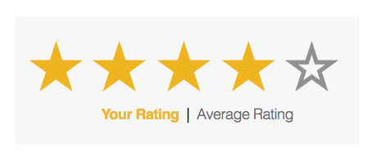
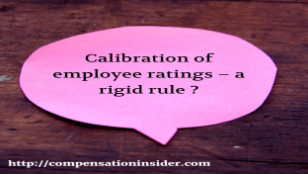


Comment Ratings Classifier
Presented By: Sahib Hussain
Internship 17

Slide 2
Problem Statement
We have a client who has a website where people write different reviews for technical products. Now they are adding a new feature to their website i.e. The reviewer will have to add stars(rating) as well with the review. The rating is out 5 stars and it only has 5 options available 1 star, 2 stars, 3 stars, 4 stars, 5 stars. Now they want to predict ratings for the reviews which were written in the past and they don’t have a rating. So, we have to build an application which can predict the rating by seeing the review

Slide 3
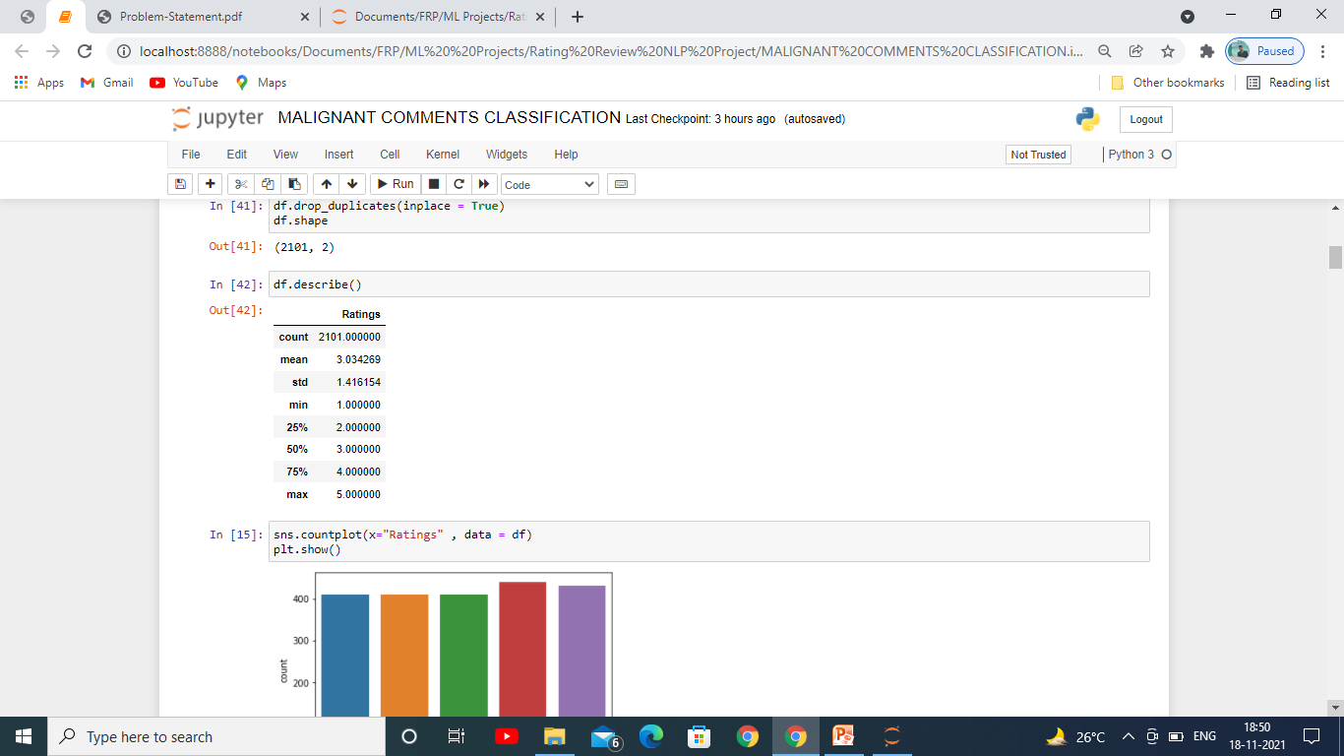
Statistics of Dataset
This dataset had comments from various users which we had to clean and preapare for building the model. From the picture we can see all the output variables ‘ mean, Standard Deviation , the Minimum, 25th,50th,75th quartiles and the Maximum.

Slide 4
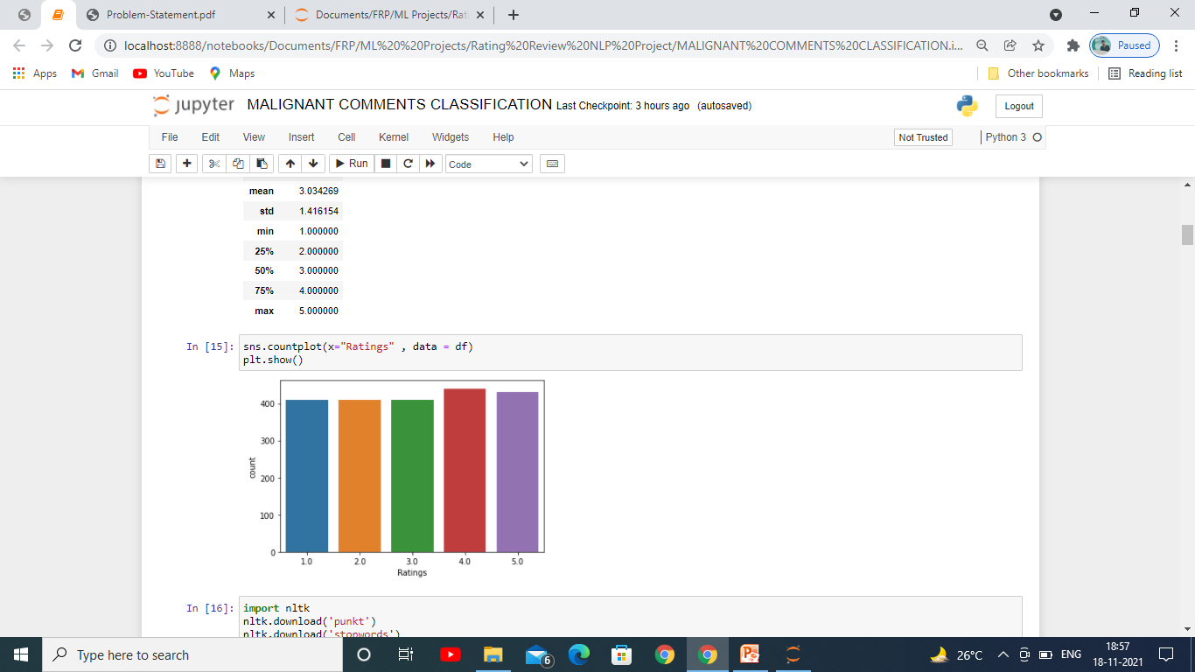
Checking Dependent Variable
The figure above we see the value count for each of the comment which we got after scrapping from website. As from this figure it is clear that there is hardly any imbalance in the dataset which we had scraped.

Slide 5
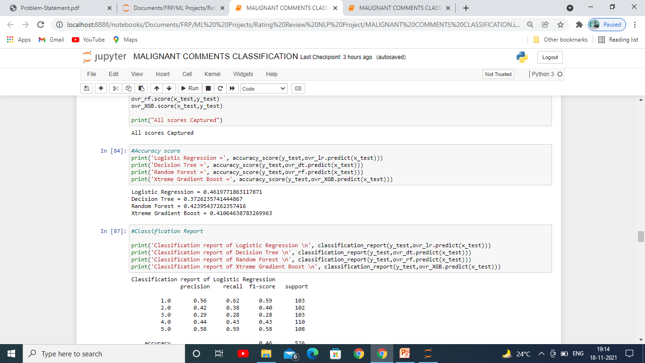
Model Selection
This figure is showing us which of the algorithm performed on this train dataset is giving us the best accuracy out of all the algorithms that we used on this dataset, Logistic Regression is giving us the best result .

Slide 6
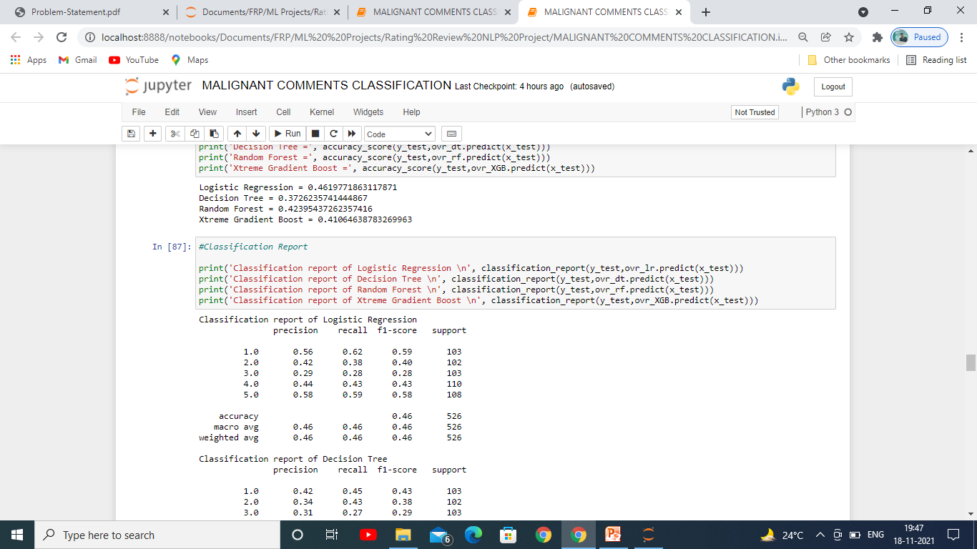
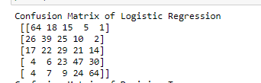
Logistic Regression Results
Accuracy Score
Classification Report
Confusion Matrix
After doing the evaluation of all the algorithms with each and every metrics for classification problem, we saw that the Logistic Regression Algorithm was giving us the best results. Above are the results of each and every metric and we can see it is giving us the accuracy of 46.19.

Slide 7
Conclusion
In this project we found various ratings of comments which are given by users in the form of review for electronic products . It helps us a lot in understanding how the product has performed and what could be the future of these products and how these can be modified to improve its performance to boost the sales or predicting its future.

